Slide 1



Indoor 3D Reconstruction from Laser Scanner Data
Smart Indoor Models in 3D (SIMs3D)
Shayan Nikoohemat
November 2018
Promoter: Prof. Dr. Ir. George Vosselman

Slide 2
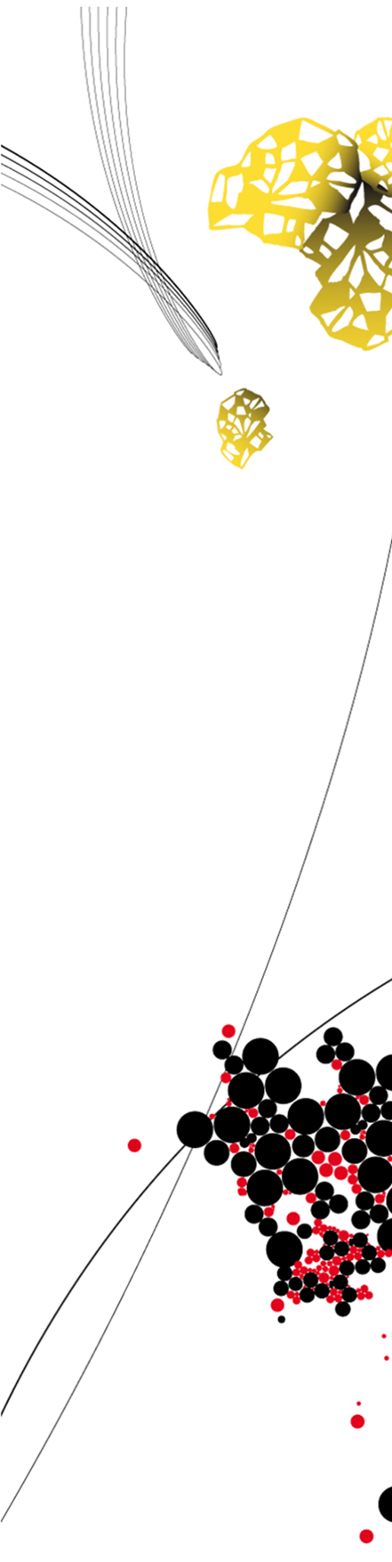
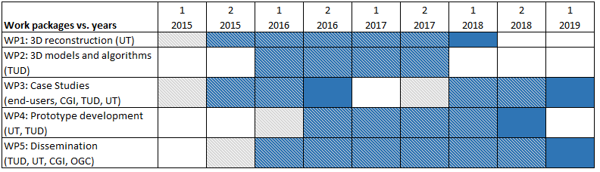
Indoor 3D Model Reconstruction to Support Disaster Management in Large Buildings
Smart Indoor Models in 3D (SIMs3D)

Slide 3
Exploiting MLS Trajectory for Interpretation of Indoor laser Scanner Data
List of improvements to the current algorithms:
Floor separation using the trajectory
Extracting the stair cases
Trying the algorithm on non-Manhattan World buildings (slanted wall, sloped ceiling)
Recovery of reflected points caused by reflective surfaces
Improving the space partitioning to 3D instead of 2.5D
… and of course write all of it in a paper ☺

Slide 4
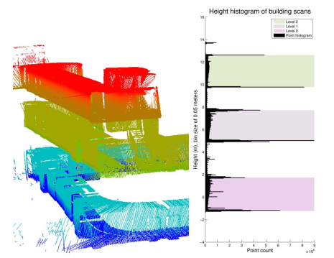
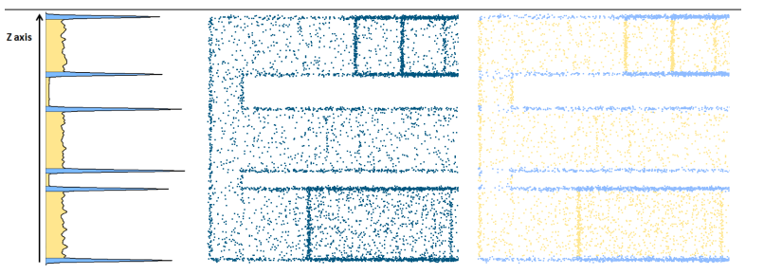
Exploiting MLS Trajectory for Interpretation of Indoor laser Scanner Data
Floors Separation:
Use the z-histogram to find the picks as floors
Turner et al. (2015)
Oesau et al. (2014)

Slide 5
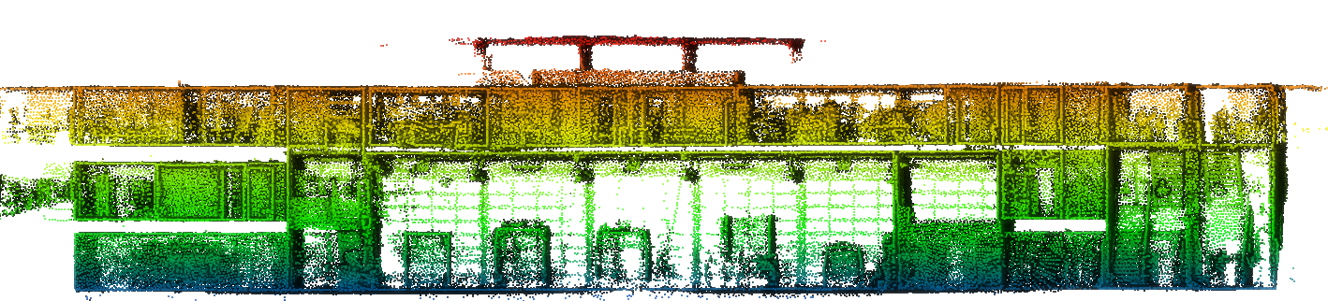


Exploiting MLS Trajectory for Interpretation of Indoor laser Scanner Data
Floors Separation:
Use the z-histogram to find the picks as floors
Point clouds of
a-three-floor building
(Mezzanine Architecture)
Floor separation by
z-histogram

Slide 6
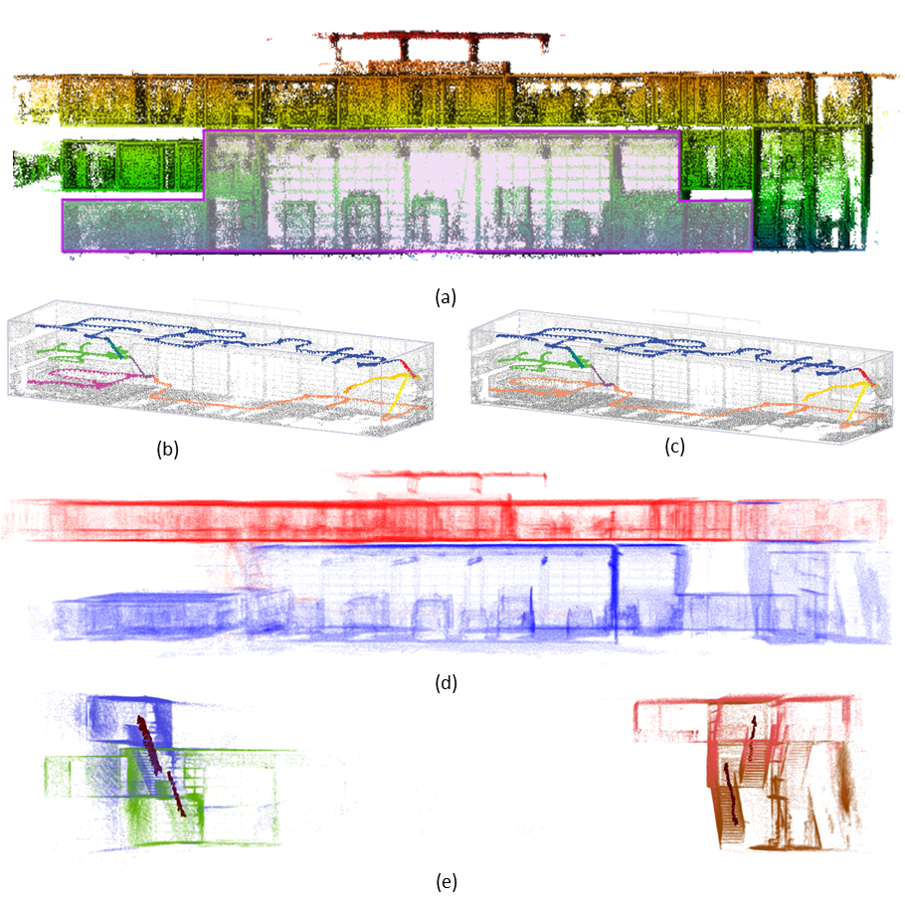

Exploiting MLS Trajectory for Interpretation of Indoor laser Scanner Data
Floors and Stairs Separation:
The trajectory is used for floor separation.
The trajectory is segmented.
Associated points of each trajectory segment are selected as a space partition.
Segmented trajectory

Slide 7
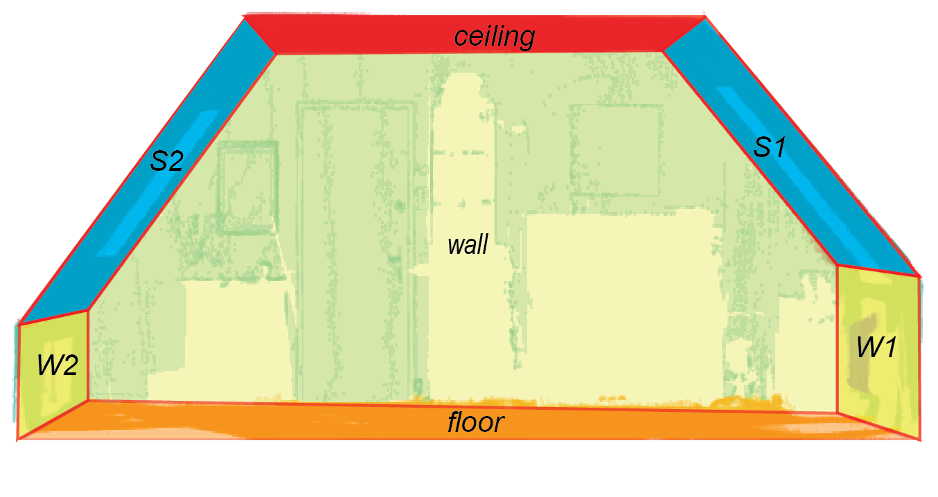
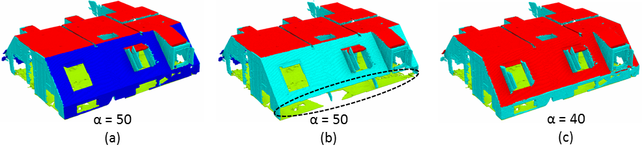
Towards Smart Indoor 3D Models Reconstructed from Point Clouds
Structure Detection in non-Manhattan World Buildings: data from Mura et al (2016)
Using the support relation between two almost-vertical wall candidates to detect slanted walls
supported
supporter
Adjacency graph
Slanted Wall and non-horizontal ceiling detection based on different angle threshold

Slide 8
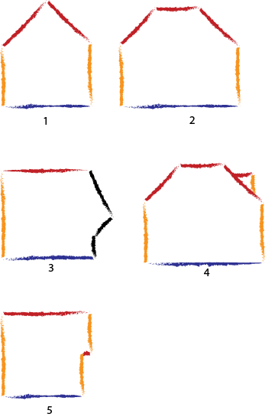
Towards Smart Indoor 3D Models Reconstructed from Point Clouds
Structure Detection in non-Manhattan World Buildings
Case 1, 2, 3 and 4 could be handled.
Case 5 can be problematic. Because the lower ceiling could be removed during the process.
Ceiling
Floor
Wall
Slanted Wall

Slide 9
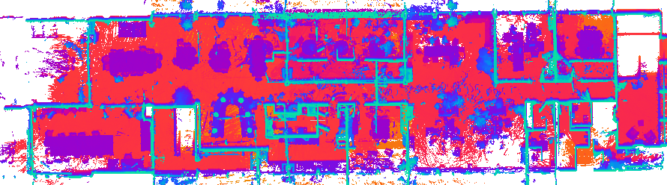
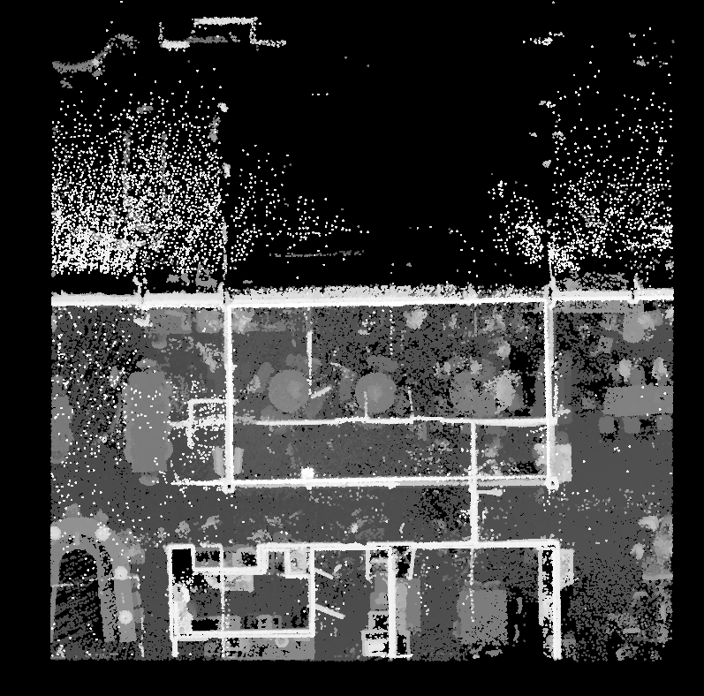
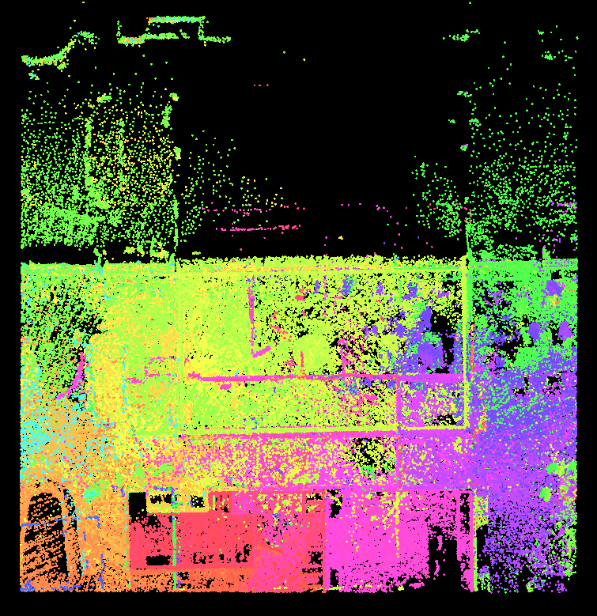
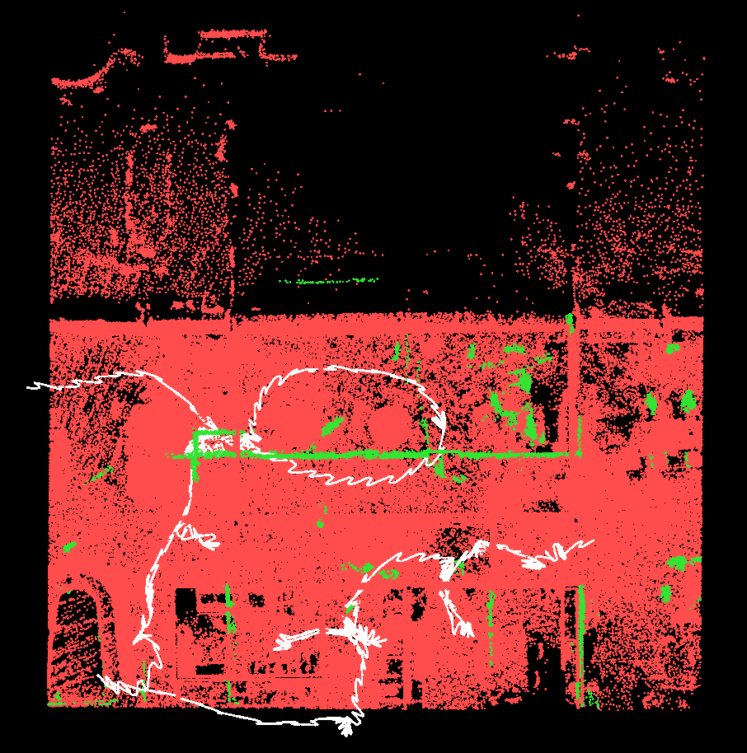
Removing reflected points
caused by glass surfaces:
Top view of a room with reflected surfaces, yellow area.
Top view of the same area,
colored by time.
Top view. Reflected segments are green.

Slide 10





Recovering reflected points
caused by glass surfaces:
Trajectory
Ghost Wall
Wall
Glass
(a)
(b)
(c)
(d)
(e)
Perspective view of a wall, glass and a reflected surface
Top view of the same area
Top view: recovery process

Slide 11
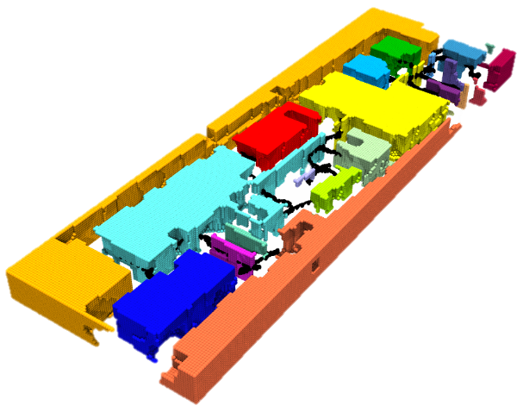
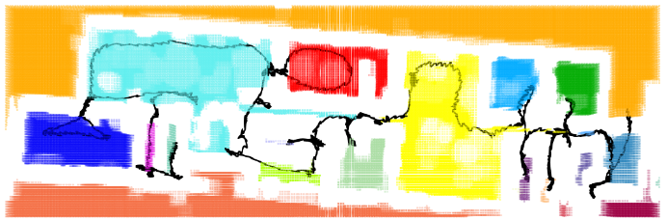
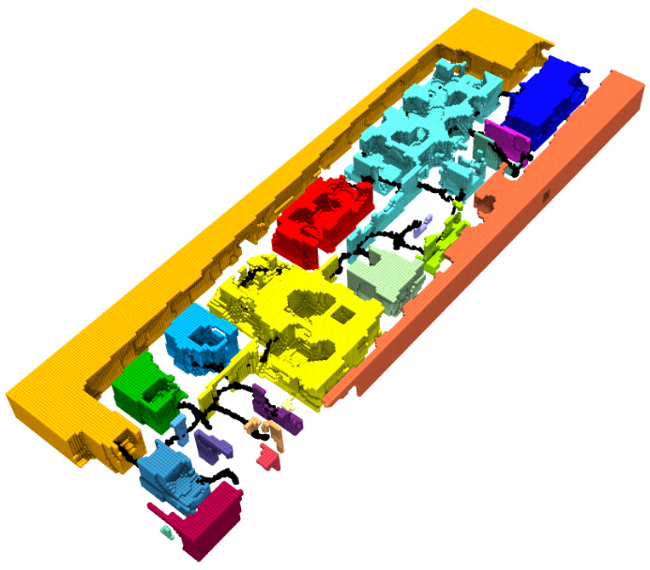
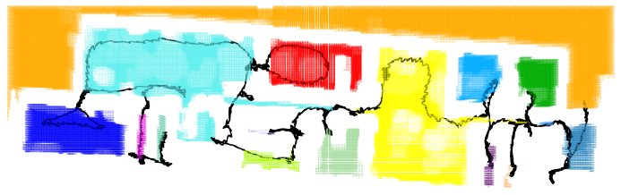
Towards Smart Indoor 3D Models Reconstructed from Point Clouds
Improving Space partitioning and navigable space:
Intersection of the space partitions with the trajectory
Perspective
view
Removing partitions outside the building
Bottom view of partitions
and the trajectory

Slide 12
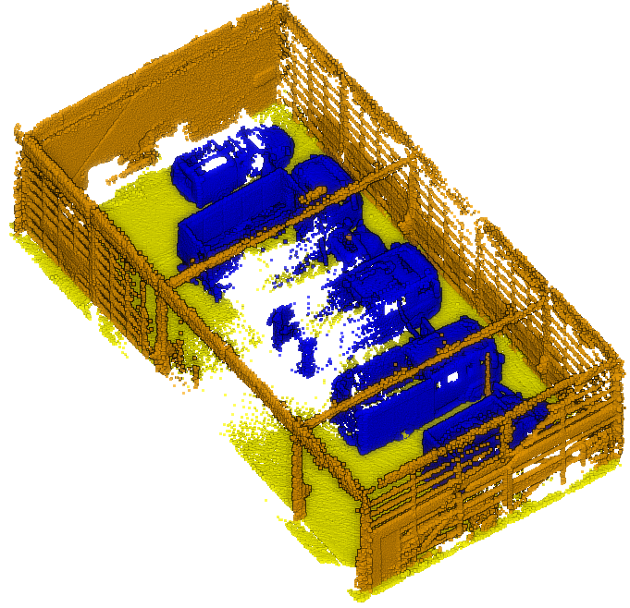
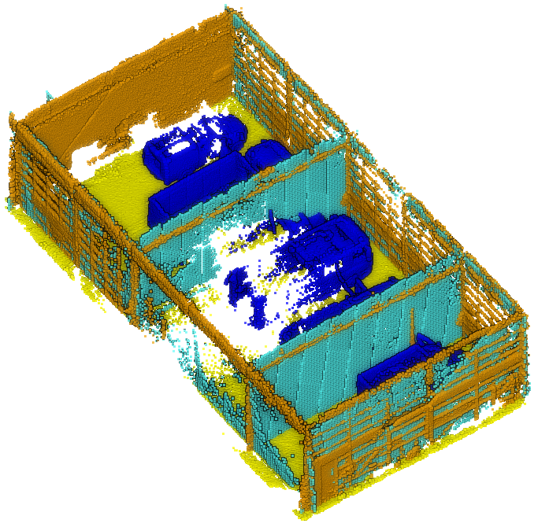
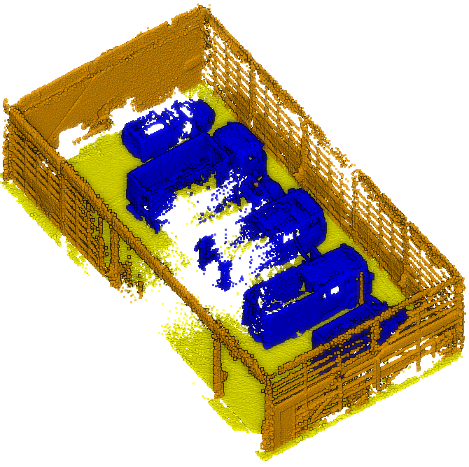
Towards Smart Indoor 3D Models Reconstructed from Point Clouds
Detecting Misclassified Walls:
Misclassified Walls
Detection
Correction

Slide 13
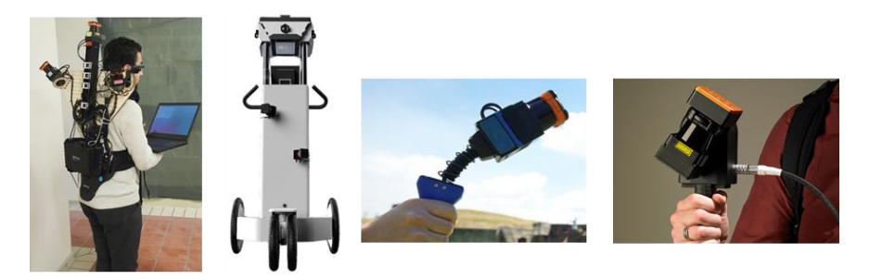
Towards Smart Indoor 3D Models Reconstructed from Point Clouds
Tested MLS Devices:
ITC backpack
NavVis M6
Zeb1
ZebRevo

Slide 14
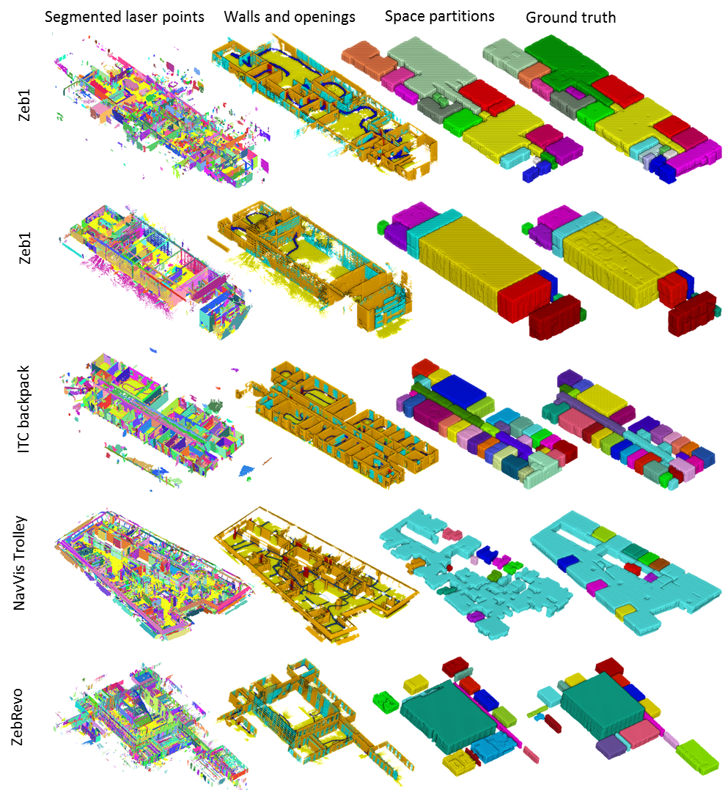
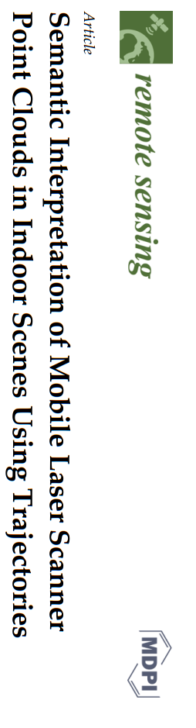

Slide 15
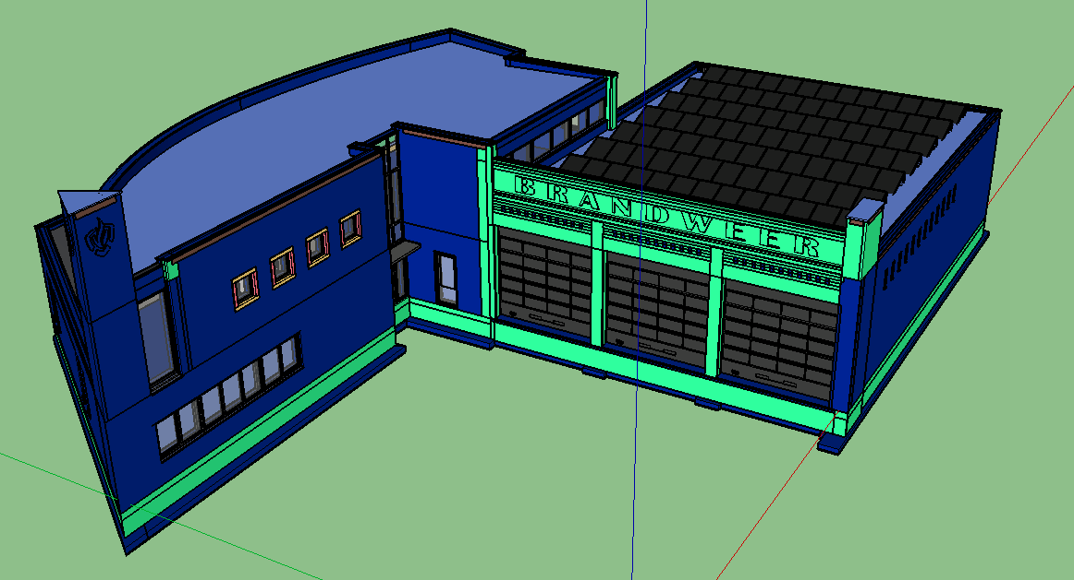
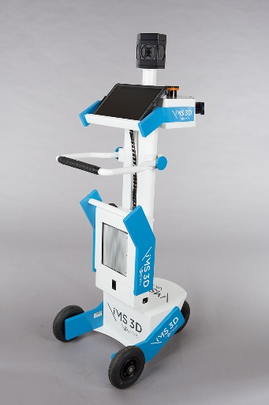
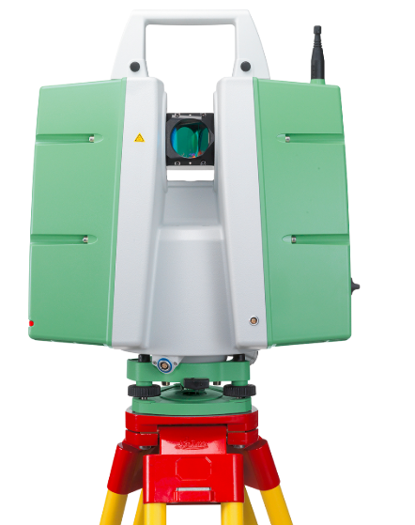
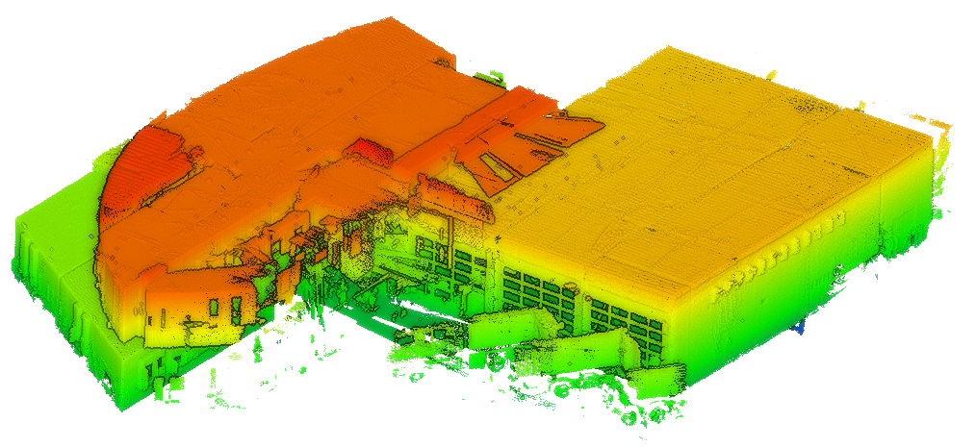
Indoor 3D Model Reconstruction to Support Disaster Management in Large Buildings
WP3. Use Case
Scanning a complex multi-storey building
Compare the result with the BIM model
iMS3D-Viametris
ITC backpack
Leica P20

Slide 16
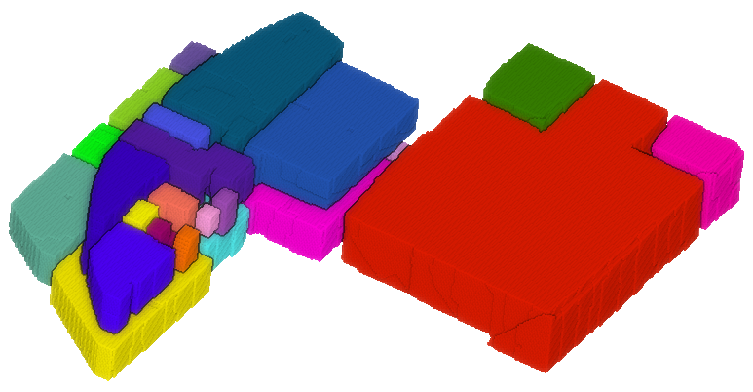
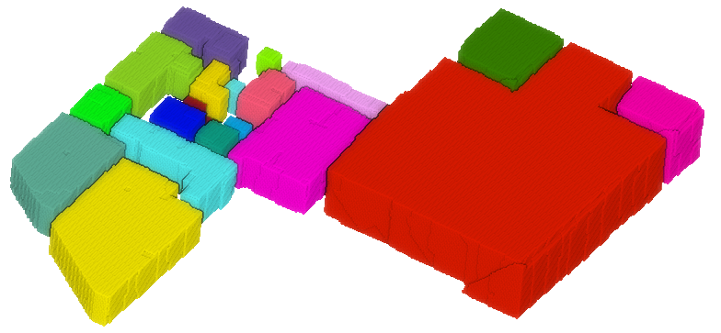
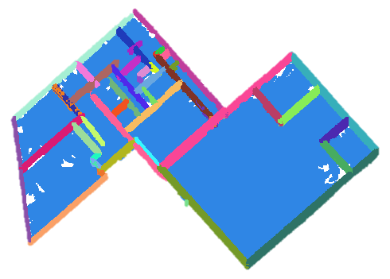
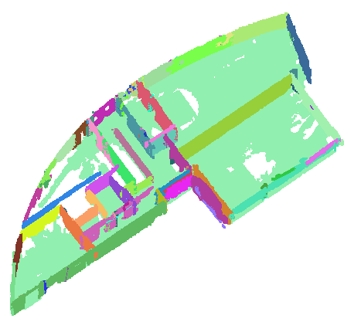
Indoor 3D Model Reconstruction to Support Disaster Management in Large Buildings
WP3. Use Case
Flexible Space Subdivision (FSS) for accessibility
analysis (TUD method)
Making a final 3D model
BIM Model
Space partitions
first floor
second floor

Slide 17
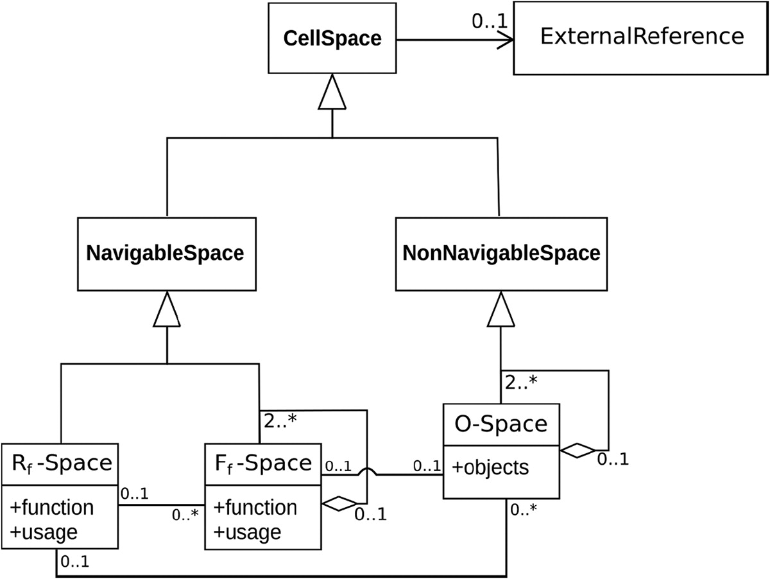
Indoor 3D Model Reconstruction to Support Disaster Management in Large Buildings
Smart Indoor Models in 3D (SIMs3D)
Integration of WP1 and WP2
WP2
(Space Subdivision)
WP1
(Geometry Extraction)
Free space
Navigable space
Doors, openings
Clutter, obstacles
Walls, floor, ceiling
indoor
point clouds

Slide 18
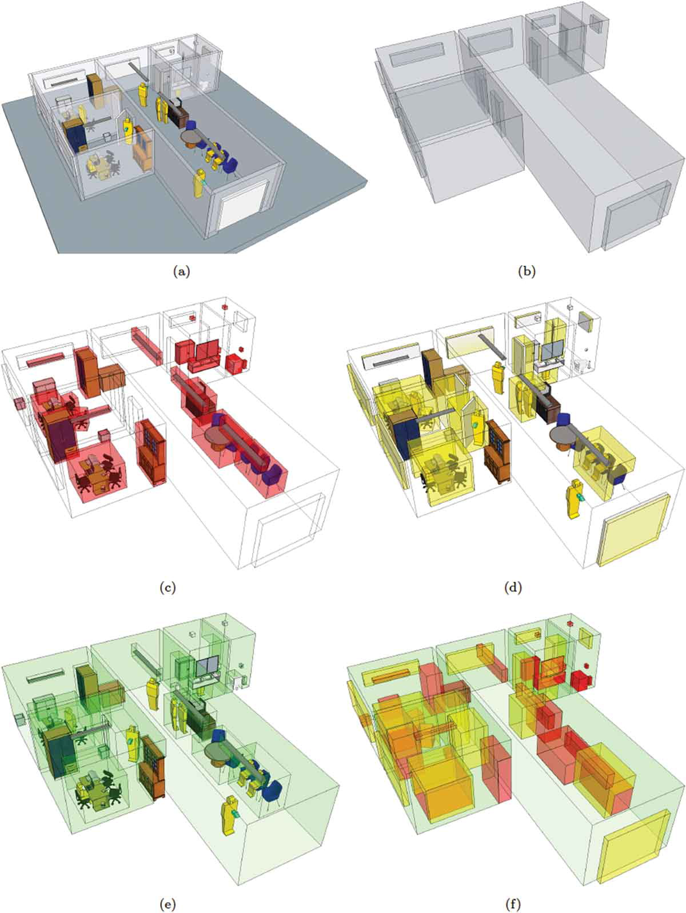
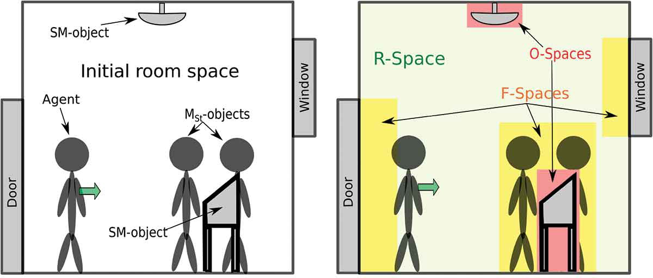
Indoor 3D Model Reconstruction to Support Disaster Management in Large Buildings
Smart Indoor Models in 3D (SIMs3D)
WP2. 3D Models and Algorithms
User Centered Space Subdivision
Functional Space
The Flexible Space Subdivision (FSS) Framework
Object-Space, Functional-Space
and Remaining-Space (navigable space)
FSS of a BIM model

Slide 19

Indoor 3D Model Reconstruction to Support Disaster Management in Large Buildings
Smart Indoor Models in 3D (SIMs3D)
Integration of WP1 and WP2
Motivation: using the real data to subdivide the space based on the permanent structures and dynamic objects (furniture) and agents
Ongoing Publication: Automation in Construction
(5 yrs impact factor 4.4)
Fixing undershooting problems
e.g. walls are not connected
Generate volumetric walls
Expected submission: End of January

Slide 20
Indoor 3D Model Reconstruction to Support Disaster Management in Large Buildings
Smart Indoor Models in 3D (SIMs3D)
Conclusion:
The methods are tested successfully in different scenarios and various MLS devices.
The manual corrections are trivial for an expert
The accuracy of results is strongly dependent on the sensor accuracy and the noise.
Future Work:
Further work will be done for consistency check of the model during the integration process.
Possibility of doing an internship abroad.
Valorisation of the results in the future spin-off

